Slide 1
Project Management Tool
Zeroth Review
19z219 – Indra Shekar G
19z241 – Sanjai M
19z245 – Soumen Saha
19z261 – Vivekanandhan S
19z263 – Manoj S
20z431 – Harish N R

Slide 2
Table of Contents
Problem Statement
01
Introduction
02
03
Features
04
Stack used
05
Timeline

Slide 3
Introduction
Software for project planning, scheduling, resource allocation, and change management is known as project management software. It enables cost control, quality management, and document management for project managers (PMs), stakeholders, and users. It may also be used as an administration system. Software for project management is also utilised for stakeholder participation and communication. Project management tools are a collection of software created to assist project teams in project planning, project tracking, and project management in order to meet project goals within a certain time frame. Additionally, it fosters productive teamwork and speeds up tasks so they may be completed within the given deadlines.

Slide 4
Problem Statement
Project management tools are a collection of software created to assist project teams in project planning, project tracking, and project management in order to meet project goals within a certain time frame. Additionally, it fosters productive teamwork and speeds up tasks so they may be completed within the given deadlines. We made the decision to create a web application using MERN stack to implement the functions listed above.

Slide 5
Features
Task Management
Time Tracking
Project Planning
To define a project schedule, a project manager (PM) may use the software to map project tasks and visually describe task interactions.
Allows for the creation and assignment of tasks, deadlines and status reports.
Software must have the ability to track time for all tasks maintain records for third-party consultants.

Slide 6
Project Planning
Project planning is part of project management, which relates to the use of schedules such as Gantt charts to plan and subsequently report progress within the project environment. Project planning can be done manually or by the use of project management software.
These boards provide an immediate snapshot of the project to the team.
We will have an business template for all type of projects that includes:
Software Development Project
Marketing Project
Migration to other platform project

Slide 7
Task Management
In project management, a task is an activity that needs to be accomplished within a defined period of time or by a deadline to work towards work-related goals. It is a small essential piece of a job that serves as a means to differentiate various components of a project.
We will include a separate page for assigning and addressing different tasks in a project
Team lead will have permission to assign task for individual team member and delete task respectively

Slide 8
Time Tracking
Time tracking lets your team record the time they spend working on issues. you won't lose any existing data if you disable or re-enable it.
We will implement time tracking by default.
We can have visual representation for tracking the team progress.

Slide 9
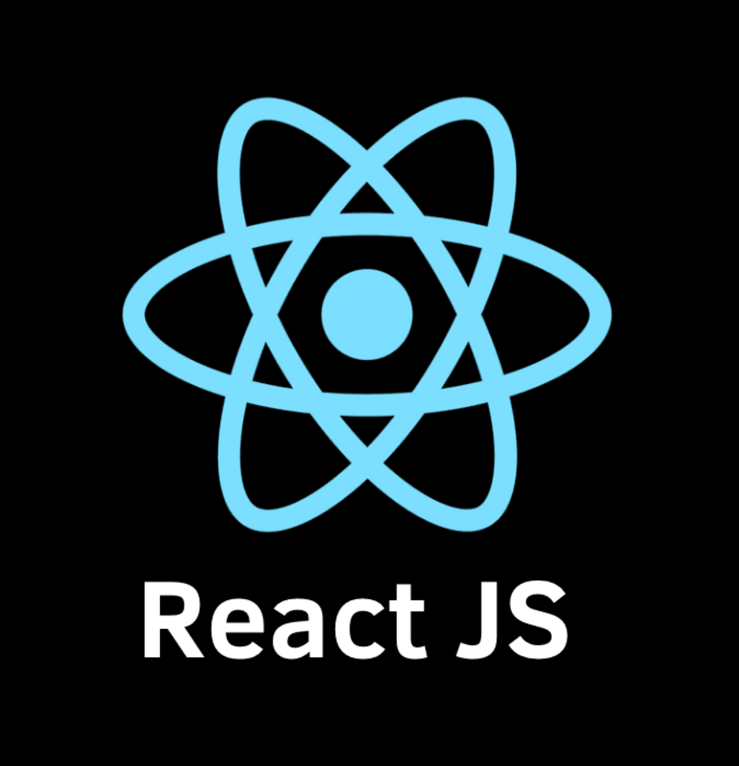
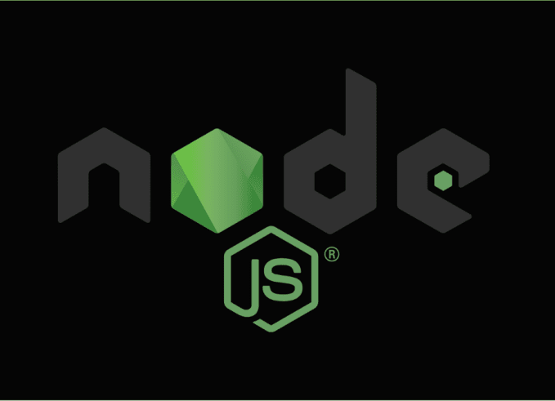
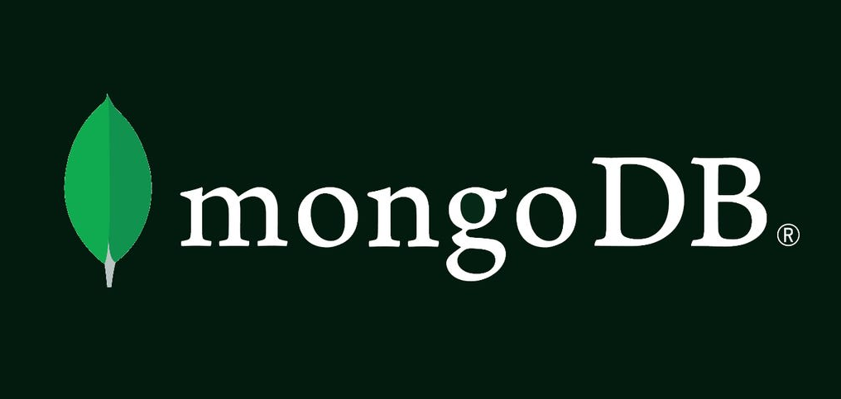
Stack Used
React js
Node js
Mongo Db
React is a free and open-source front-end JavaScript library for building user interfaces based on UI components.
Node.js is an open-source server environment. Node.js is a back-end JavaScript runtime environment.
MongoDB is a source-available cross-platform document-oriented database program. Classified as a NoSQL database program.

Slide 10
Time Line
Integration
Designing
Integrating Frontend, backend, Database before 30-03-2023
UI/UX designing before 15-01-2023
Frontend
Backend
Implementing Design using ReactJs before
27-01-2023
Building Api endpoints and creating features before 27-02-2023

Slide 11
Thank you
19z219 – Indra Shekar G
19z241 – Sanjai M
19z245 – Soumen Saha
19z261 – Vivekanandhan S
19z263 – Manoj S
20z431 – Harish N R

